Slide 1
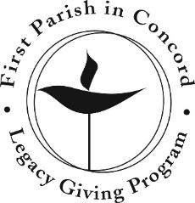
How does the Legacy Program work?
There are several options available to you. The Legacy Giving Committee is available to answer your questions. You should also work with your family, financial advisor, or estate attorney to select the approach that is right for you.
Bequests
A bequest is a provision in your will or revocable trust that designates a fixed dollar amount, a percentage of your assets, or the remainder of your estate to be given to First Parish upon settlement of your estate. There is no minimum amount for a gift by bequest.
Retirement Plan Beneficiary Designations
You can also designate First Parish as a beneficiary of your IRA, 401(k), or 403(b) plan, for a specific amount or a percentage of the total assets. Such gifts can save on income and estate taxes.
Life Insurance Beneficiary Designations
You can designate First Parish as a beneficiary of all or a portion of your life insurance benefits. If the original purpose of the policy no longer applies, the policy benefit can help support worthwhile causes such as First Parish.
Charitable Gift Annuities
A charitable gift annuity provides income to you and/or your spouse in exchange for initially depositing a fixed amount of funds (minimum $10,000). You will receive lifetime income and First Parish will receive any remaining assets upon your death. Our program is professionally managed by the Unitarian Universalist Association.
Other Programs and Mechanisms
There are other approaches to your legacy gift. We encourage you to consult with your financial advisor and/or estate attorney to determine the best approach for you.
I’m interested. What do I do next?
We are gratified and truly appreciate your commitment to First Parish. Here is the “pathway” for moving toward making your legacy gift:
Visit the section of the First Parish website on Legacy Giving or pick up a copy of the Legacy Giving Program Guide from First Parish Office.
Talk with your advisors and family and decide on the type of approach you prefer.
Contact our Director of Operations or a Member of the First Parish Legacy Giving Committee. Let us know what you are considering and whether you need assistance.
Execute your legacy gift. Make the required changes to your will, trust, or beneficiary designations, or set up your charitable gift annuity or other program.
Complete the Legacy Gift Form and send it to the First Parish Director of Operations. We want to understand your gift and keep this record. The amounts and terms will be held in confidence.
You will be welcomed as a member of our First Parish Legacy Giving Circle.
Upon the settlement of your estate, your funds will be added to the First Parish Legacy Investment Fund and will serve to support the mission and activities of First Parish for years to come.
What is a Legacy Gift?
A legacy gift is a financial commitment made to First Parish now that the church will receive in the future. The most common legacy gifts are bequests in your will or revocable trust. When your estate is settled, that portion of your assets earmarked will be given to First Parish to provide support in future years.
Why should I make a Legacy Gift?
First Parish is a wonderfully rich community, engaged in much good work. To finance these efforts, we must raise money each year through our annual pledge campaign. This places significant stress on our fundraising efforts, especially in times of economic uncertainty. The solution is to grow our Legacy Investment Funds (the investment fund managed by the First Parish Trustees).
Since 1885, gifts have been made to the First Parish Legacy Investment Fund. It provides about 9% of our annual budget. If we grow this Fund, it will assure we have sufficient funds annually to support our work. Your legacy gift shows your deep and long-term commitment to First Parish. It will live on beyond your years, and nourish the values we all share. Best of all, a legacy gift can be made by anyone.

Slide 2
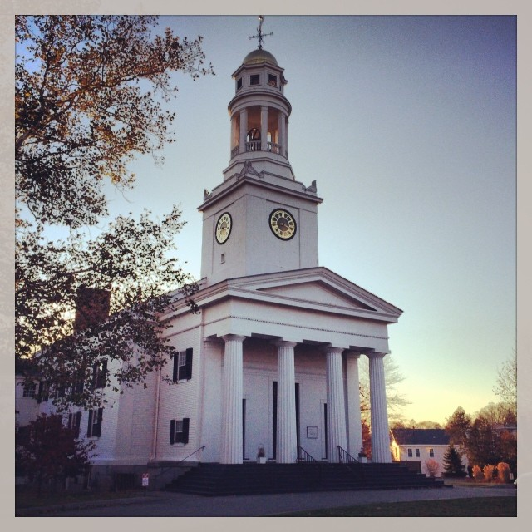
First Parish in Concord Legacy
Giving Program
Why Legacy Gifts are Important to
First Parish in Concord
Our annual budget is highly dependent on the pledges of our parishioners, and the economic conditions that exist each year. A growing Legacy Investment Fund can provide income security and continuity to our operations.
First Parish is a community of activists. Over our 350 year history, many parishioners have been involved in making the world a better place. This work is now even more important as we stand up for the values we share. Your legacy gift supports the efforts of future activists for generations to come. Your voice and your presence will live on through the support you make today
By making your legacy gift, you are making a contribution that lasts forever. Your funds are not used for immediate expenses, but rather are pooled with other legacy gifts, invested and managed by the Trustees of First Parish Donations. Your legacy gift then grows and provides ongoing support to the church. Think of your legacy gift as an asset that replaces your pledge and lives on in your name.
Who to contact:
Fifi Ball, Director of Operations, email: fball@firstparish.org
Tom Wilson, Chair
email: twilson@wilsongroup.com
Philip vanderWilden, Treasurer, the Trustees of Parish Donations
email: philipv@crawford-idema.org
First Parish Legacy Giving Committee (see the First Parish website under Giving / Legacy Giving)
Laura Randall, UUA Office of Legacy Gifts, 617-948-6511
Visit the Legacy Giving Program website at
http://firstparish.org/giving/legacy giving
November 2017
How you can assure First Parish in Concord has the resources to enable future generations to:
Deepen spiritually
Build community
Make a positive difference in the world

